Slide 1
Introduction to Python for Data Science DSECLPFDS / AIMLCPFDS
BITS Pilani
Pilani|Dubai|Goa|Hyderabad
Radhika B
1

Slide 2

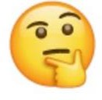
Agenda for CS #1
Ground Rules
Introduction to DSECLPFDS / AIMLCPFDS
Motivation & Objective
Courseware, LMS Walkthrough
Books & Evaluation components
Pedagogy for this course ?
Course Schedule
Getting started with Module 1
Q&A
Feedback

Slide 3
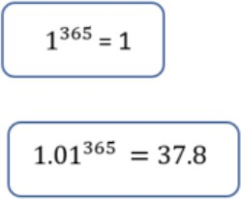
Ground Rules!
Mentally present – Observe!! Listen!!
Keep your questions for the Q&A section / Discussion Forum
Use the Discussion Forum in LMS Portal effectively
Do not post unrelated messages in MS Teams. React using the “Like” feature if your intended message has already been posted.
Solve the exercises regularly! Connect!
Go that “extra mile” ☺

Slide 4

Motivation for this course ?
Motivation
As of now, Python is one of the most widely used programming
languages in the Data Science field.
Data Scientists just love Python!
Python is easy to learn & has a great community for support!
We would use Python for all the assignments / case-studies (For all the subjects in MTech DSE / MTech AIML).

Slide 5
Course Objectives
What is this course about ?
Introduce the fundamental programming concepts of Python
Enable you to solve data problems using Python
Act as a kick-start / bridge for participants of the DSE/AIML programme who are new to Python.
MTech
What is this course not about ?
Comprehensive, in-depth discussion about Python programming.
Comprehensive, in-depth discussion about data analysis using
Python and related packages, libraries, and tools.

Slide 6
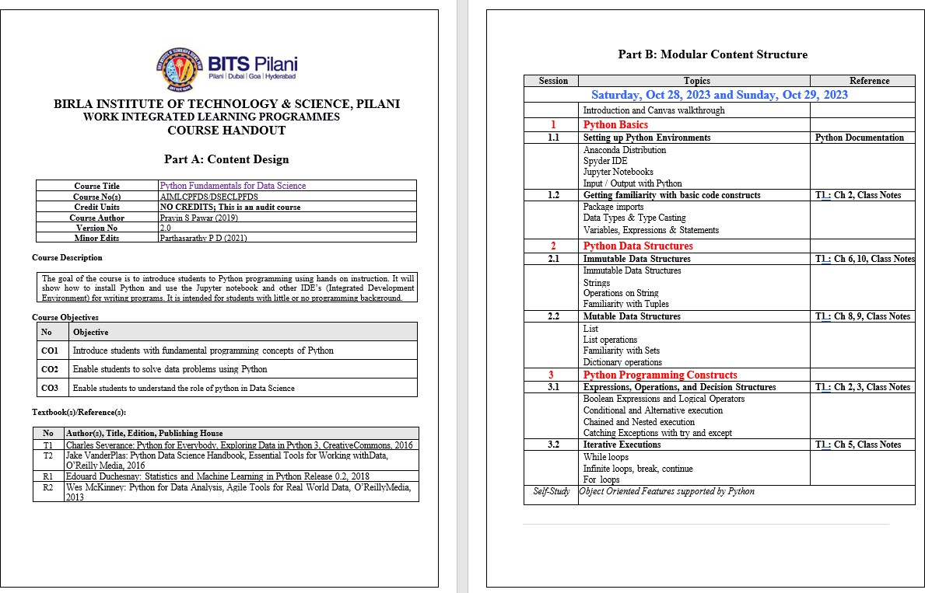
Courseware
Available on canvas (Home page).

Slide 7
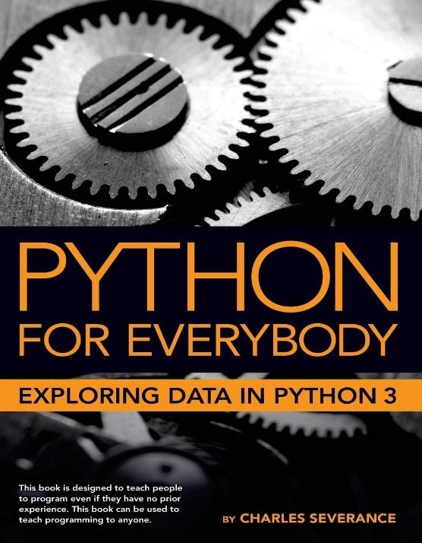
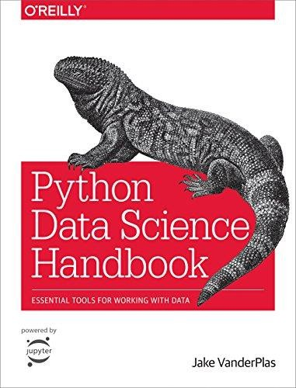
Text Books
Charles Severance: Python for Everybody, Exploring Data in Python 3
Jake VanderPlas: Python Data Science
Handbook
eBooks of both are made available in Canvas (Course → Files → Books).
Do not publish these on the Internet. For our use, we have got permission from the authors to use the eBook.
Note: These are the prescribed ones. Please feel free to explore any Python materials that suits you.
7

Slide 8
Evaluation Components
This course is NOT evaluated !!
You will not have any exams for this course ☺
Nevertheless, there would be some exercises for you to try and hone your skills: [No need to submit].
These will be on Canvas so you get accustomed to the Canvas LMS.
There will be “Assignments”
There will be “Quizzes”

Slide 9









Pedagogy for this Course
Step 02: Explore
You explore the additional notebooks. Get your hands dirty with Python
Practice more examples for each concept.
Step 01: Class Session
We learn Fundamentals !
Look at few examples for each concept.
Step 03: Doubts
Put your queries in Discussion Forum.
Peers and TA to answer …
Non-Beginners: You can directly start with Step 02 and also use this phase for additional learning which might help in future … You play an important role in Step 3 as well in answering your peer’s queries.
9

Slide 10
Today’s Schedule
Today – S1 (5:30-8:30 PM)
Motivation & Agenda Python Basics Setting up Python Environment Package imports Data Types & Type Casting Variables, Expressions & Statement

Slide 11
Program & Programming Language
Computer Program
Set of instructions that perform a specific task executed by computer
Required by computer to function
Written by programmer using programming languages
Like C, C++, Java, Python etc.
Executed with compiler and interpreter

Slide 12
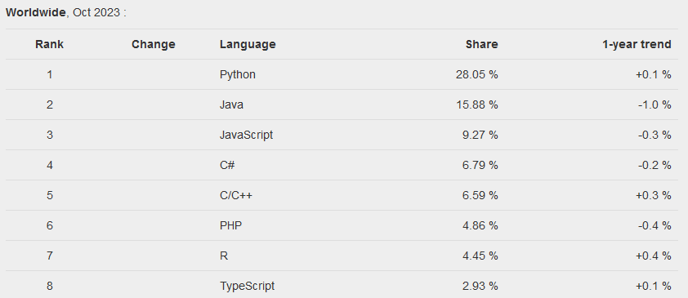
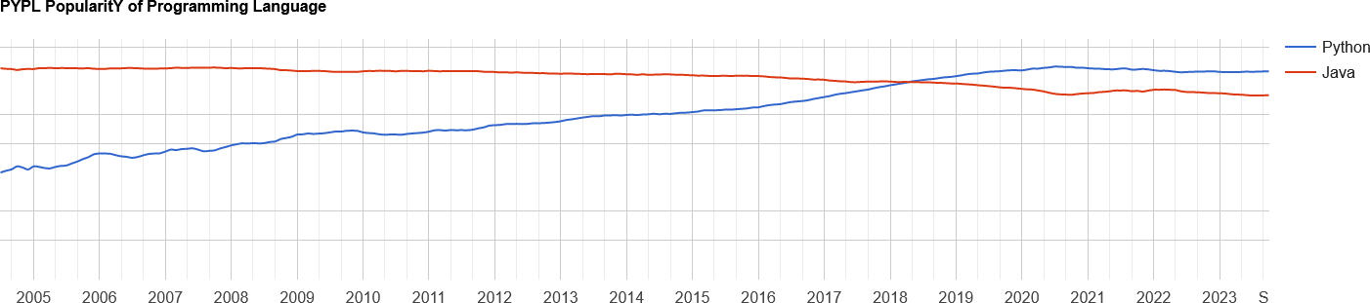
Python as a Programming Language
Why Python ?
Worldwide, Python is the most popular language … Source : http://pypl.github.io/PYPL.html

Slide 13
Python as a Programming Language
Python
Designed by Guido van Rossum around 1990
Not just a scripting language
Easy to learn, read, use
Extensible (add new modules)
Highly readable
Latest Version 3.11.x
Most fond of language for Data Scientists
Touchy Feel Properties
Open Source
copyrighted but use not restricted
owned by independent non-profit, PSF
Mature (30+ years old)
Supportive user community
plenty of good books, too
Active user community
Simple design, easy to learn
reads like “pseudo-code”
Suitable as first language
Suitable as last language :-)
(Hopefully)

Slide 14
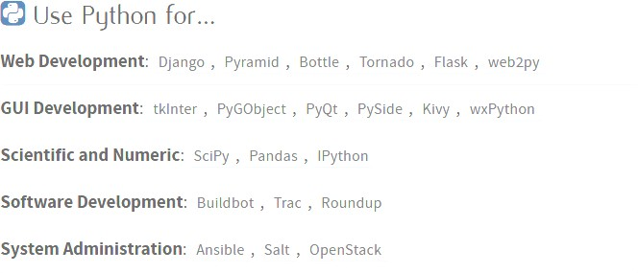
Python Applications

Slide 15
Python Ecosystem
Components of Python World :
Core Python
Distributions
Frameworks / IDEs
Third party Libraries
Core Python
Programming Language itself
Some standard modules are available
Other packages needs to be explicitly installed
Python Distribution
Python + packages
Majority of packages, libraries are already
available
Package management is simplified
Anaconda from Continuum Analytics
IPython and its IPyKit variant

Slide 16
Python Ecosystem
Frameworks / IDEs
Use frameworks to create code and
develop applications
Provides a defined structure to the developers so that they can focus on the core logic of the application rather than on other elements
Python web framework
Django
Web2py
Flask
Python IDEs
IDLE
PyCharm
Spyder
Third party Libraries
Makes life of developers very simple
Just need to know the right library to carry out a task
NumPy
Scipy
Pandas
Matplotlib
Seaborn
Bokeh
ScikitLearn
And List goes on …
✓ Jupyter Notebooks

Slide 17
Python Installation
Three Ways :
Install Python directly
Install the Python language with installer
Need to install other packages explicitly using pip install
https://www.python.org/downloads/
Use Python distribution
The open-source Anaconda Distribution is the easiest way to perform Python coding
Works on Linux, Windows, and Mac OS X
https://docs.anaconda.com/anaconda/install/windows/
Use Cloud based services
The simplest of all but needs internet connectivity to use
Microsoft Azure Notebooks
– Google Collab

Slide 18

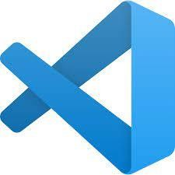

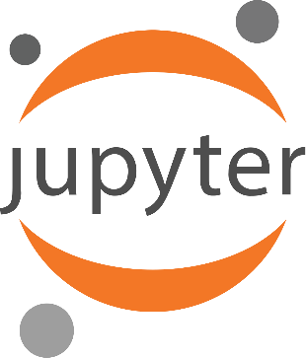
Integrated Development Environments (IDE) for Python
Common IDE’s:
Our Favourite (For WILP Programme):
.py is a regular python file. It's plain text and contains just your code.
.ipynb is a python notebook and it contains the notebook code, the execution results and other internal settings in a specific format.

Slide 19
Input / Output with Python
print() can be used to output a message
input() can be used to enter an input to the python program.
# can be used to provide comments.
(triple quotes) can be used to write documentation.
Demo:
Let’s see how to launch Jupyter Notebook
See the basics of Notebook
Practice some I/O statements and comments.

Slide 20
Basic Code Constructs
Imports:
Import in Python is similar to #include in C/C++. Python modules can get access to code from another module by importing the file/function using import.
Ex: import math
print(math.pi) Variable
A Python variable is a reserved memory location to store values. In other words, variables are containers for storing data values.
Python has no command for declaring a variable.
A variable is created the moment you first assign a value to it.
Ex: a = 100
20

Slide 21
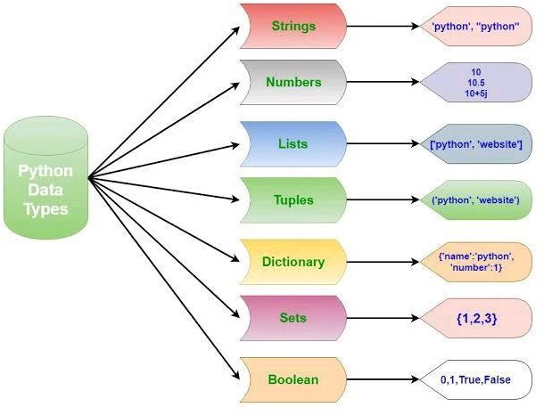
Data Types in Python
Immutable
type() can be used To find the data type

Slide 22
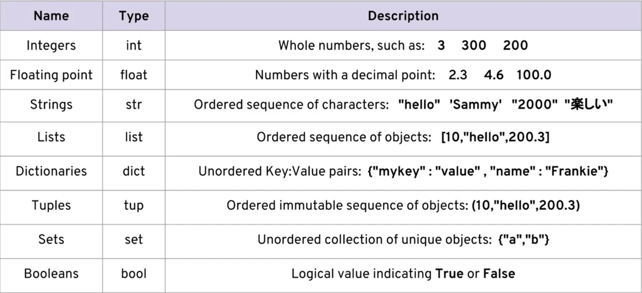
Data Types in Python
type() can be used to find the data type

Slide 23

Post your queries in the Discussion Forum!!

Slide 24






Feedback
: 5
: 3
Thank You for your time & attention !
Contact : radhika.richy@wilp.bits-pilani.ac.in
: 1

